Slide 1


Comparison of neuroimaging profiles between PCA patients with and without unusual visual symptoms – VBM study
Professor Sebastian Crutch Priscilla Chau
Notes:
In this presentation I’ll briefly talk about: - What is PCA - What my study is about (replication of Natalie et al, 2014 study → but for PVP/ Headaches and Sensory symp) - Participants - Method → VBM - What is VBM - What I need to do next and what to expect - Limitations of study and future research/implications

Slide 2

What is Posterior Cortical Atrophy (PCA)?
Deterioration of higher visual functions (Visuospatial/ Visual perceptual) and/or recognition/ identification
Biparietal (Dorsal/Where Pathway) Occipitotemporal (Ventral/What pathway)
Typically considered a rare form of AD
Can also be caused by others syndromes such as DLB, Corticobasal degen etc
Notes:
Neurodegenerative syndrome that is characterized by impaired higher visual functions. – affecting visuospatial and visual perceptual functions
Some researchers suggests that different forms of PCA exists, affecting the biparietal (Dorsal ; Where pathway – leading to visuospatial deficits) and the occipitotemporal (ventral ; what pathway – affecting recognition and identification). Likely an overlap between these profiles. (Crutch et al, 2012; Beh et al, 2015).
Typically PCA is sometimes considered a rare form of AD because AD is often identified as the most common underlying pathology
However it can also be caused by other syndromes such as DLB (Picks) & Corticobasal degeneration (CBD). Can also coexist/ overlap with other syndromes.

Slide 3

My research project…
Natalie et al, 2014
Corticobasal syndrome like motor features in PCA (asymmetric sensorimotor signs)
VBM – grey and white matter diff, cortical thickness and subcortical volumetric analyses
Greater atrophy of contralateral sensorimotor areas
Notes:
My study is a replication of Natalie et al, 2014 study. Based on same methods and principles.
By using voxel based morphometry (VBM), Natalie et al (2014) explored the relationship and overlapping motor features of those with PCA compared to those without. By looking at grey and white matter differences, cortical thickness and subcortical volumetric analyses, they hypothesized that PCA patients with corticobasal syndrome-like motor features ( sensorimotor signs; asymmetrical limb rigidity and apraxia etc) would have greater atrophy of contralateral sensorimotor areas of the brain.
For my study, I’ll be using the same techniques but to look at the relationship of unusual visual symptoms and PCA instead.

Slide 4

My research project…
Unusual symptoms of PCA :
Positive visual phenomenon (PVP) False visual images/ Distortions/ Long lasting persistency
Headaches Associated with PVP and other visual functions (Schankin & Goadsby, 2015; Liu et al, 1995; Gutteridge & Cole, 2001).
Sensory symptoms (unsure what is meant by sensory symptoms) ??
Notes:
For my study, I’ll be using the same techniques as Natalie et al (2014) but to look at the relationship of unusual visual symptoms and PCA instead.
3 particular symptoms of interest : 1) Positive visual phenomenon (PVP) 2) Headaches 3) Sensory symptoms ?? 4) Possibly change in sleep
PVP - lesions of visual pathways that causes a range of false visual images/ representations. - can range from optical illusions such as prolonged color after images (Chan, Crutch & Warrington, 2001), Palinopsia (persistence of visual image even after disappearance) and hallucinations. - Distortions and long lasting persistency. Headaches - Headaches is also an interesting symptoms to explore because there have been a few studies showing that it is associated with PVP and other visual functions (Schankin & Goadsby, 2015; Liu et al, 1995; Gutteridge & Cole, 2001). / Sensory symptoms? -

Slide 5

Participants
N= 58 PCA patients N= 49 PCA patients with scans
PVP = 15/49 with scans
Headaches = 14/49 with scans
Sensory symptoms = 12/49 with scans
Controls = 30 healthy controls?
PCA/Pure = Without these symptoms?
??? | ??? | ???
Class 1 | 82 | 95
Class 2 | 76 | 88
Class 3 | 84 | 90
Notes:
58 identified PCA patients but only 49 with scans
15/49 patients experience PVP 14/49 experienced headaches 12/49 experience sensory symptoms
Possible overlap between symptoms
For controls → Not sure how many to use? 30 like in Natalie’s study?
PCA/ Pure → Do I need another group to compare to – how should I identify them?
(Thinking of whether to include a graph or table to represent the data)

Slide 6
Method: Voxel Based Morphometry (VBM)
Compare different brains on a voxel-by-voxel basis
Aim: Identify differences in local composition of brain tissue between groups. Produce map of statistically sig differences.
VBM – SPM5 (Statistical Parametric Mapping, V5)+ MatLab
Cortical Thickness - FreeSurfer
Notes:
- Technique to characterize neuroanatomical differences using structural magnetic resonance images (MRI) - Global patterns of differences – DBM better - Mass uni-variate – greater sensitivity for localized regional differences in GM or WM - VBM

Slide 7
Pre-processing
Normalisation
Registering individual MRI images to same template image
Segmentation
Normalised images segmented into GM, WM, CSF
Smoothing
Ensure each voxel has average amount of GM and WM
Notes:
Mechelli et al, 2005. Wellcome department of Imaging Neuroscience
Preprocessing: The data are pre-processed to sensitise the tests to regional tissue volumes. Achieved by…
Normalisation: - Registering individual MRI images to the same template image - Corrects for global brain shape differences
Segmentation: - Normalised images segmented into GM, WM, CSF
Smoothing - Ensure each voxel has average amount of GM and WM
- Convolving with isotropic Gaussian kernel - Makes data more normally distributed – increasing validity of parametric statistical tests.

Slide 8
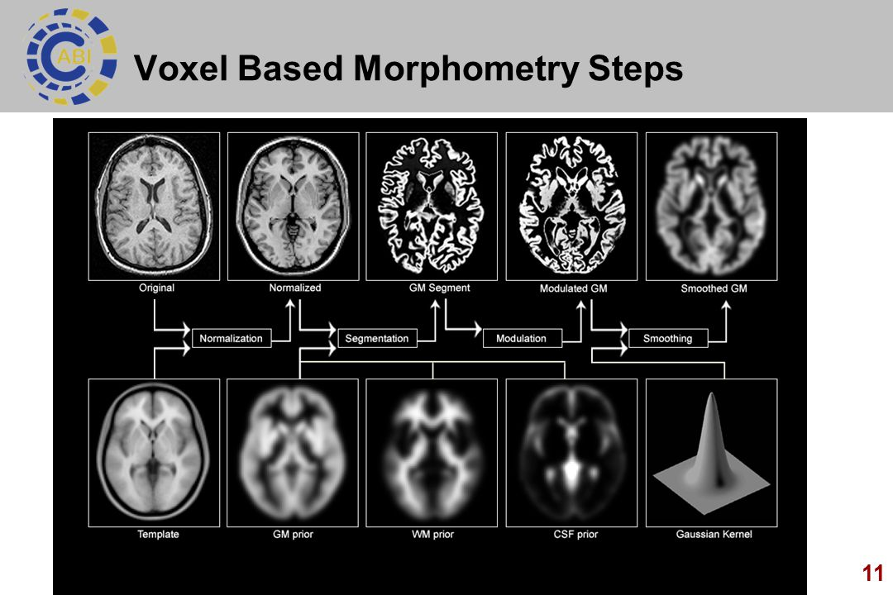
1) Original image normalized against template 2) Segmented to GM, WM, CSF 3) GM modulated to same volume prior to normalization 4) GM smoothed
Notes:
Modulation: - Another step which is optional– If you want to identify regional differences in volume for a particular type of tissue such as GM - This therefore requires the absolute volumes of the tissue to be preserved before normalization changes - So if normalization caused a particular area of the brain to double in volume, modulation corrects for this by halving the intensity of this region so that the volume is the same as it was before normalization. - With this adjustment, you can then accurately compare the volumes of specific structures which would be required in my study.

Slide 9
Summary: what I need to do next…
Extract scans from cluster
Preprocessing – some already preprocessed
(Normalization/ Segmentation/ Modulation/ Smoothing)
Run analysis
Notes:
Contemplating whether this slide is necessary

Slide 10

Analysis and expectations
General linear model
Cortical Thickness (Controlling for age, gender, scanner and total intracranial volume??)
Necessary to correct for multiple comparisons. Random field correction? Family Wise Error correction?
I would expect… greater atrophy of higher order visual areas such as V3, V4, V5 (need to do more research before I make my mind up) for patients who are experiencing PVP and ____ area for sensory symptoms.
Notes:
General linear model – allows variety of statistical tests → assess group differences in GM and WM volume in VBM analysis → t tests/ f-tests → correlations
Necessary to correct for multiple comparisons – made up of results of many voxel wise stats test (Not sure which one to use? )
V3 = Motion perception/ Representation of visual fields V4 = Orientation/ Colour/ Selective extraction of simple features - Depth perception V5 = Motion

Slide 11

Limitations/ Things to be aware of
Positive visual phenomenon not categorized
Co-morbid conditions
Age related effects
Scanners of different field strength – bias
Need to read up some more on VBM
Notes:
Positive visual phenomenon not categorized/ separated - Many different types which can involve different areas of the visual cortex /brain
Comorbid symptoms - Some patients experience more than just PVP or headaches – they can have both or all of the symptoms of interest → differences may be harder to identify so needs to be controlled for
Age related effects - which will appear significant in comparison to disease.

Slide 12

Future research/ Implications
Larger cohort for future research
Ideas of co-existing symptoms & association
Brain volume differences – function and pathways associated (example. headaches)
Notes:
Comparing clinical and neuroimaging features --> Possibility of a larger cohort for future study to understand these unusual symptoms
Open ideas to how these different symptoms co-exist/ affect one another / is associated → leading to further research if significant
If any specific area experiences greater atrophy for the symptoms of interest – gives us insight into the functions and pathways that may be associated (Migraine with aura, Retinal migraine, normal headaches).

Slide 13
References
A disorder of colour perception associated with abnormal colour after-images: a defect of the primary visual cortex. Chan D, Crutch SJ, Warrington EK J Neurol Neurosurg Psychiatry. 2001 Oct; 71(4):515-7.
Schankin, C.J. & Goadsby, P.J. Curr Pain Headache Rep (2015)
Notes:
Needs to be fixed which I’ll do later on ☺

